Slide 1

JRCAI
Deep Learning Fundamentals
Multi-Layer Perceptrons
& Training Essentials
MLP
Loss
Optimizers
Evaluation
By Ahmed Almutairi
Supervised by Dr. Safwan ALSelwi
01 / 28

Slide 2
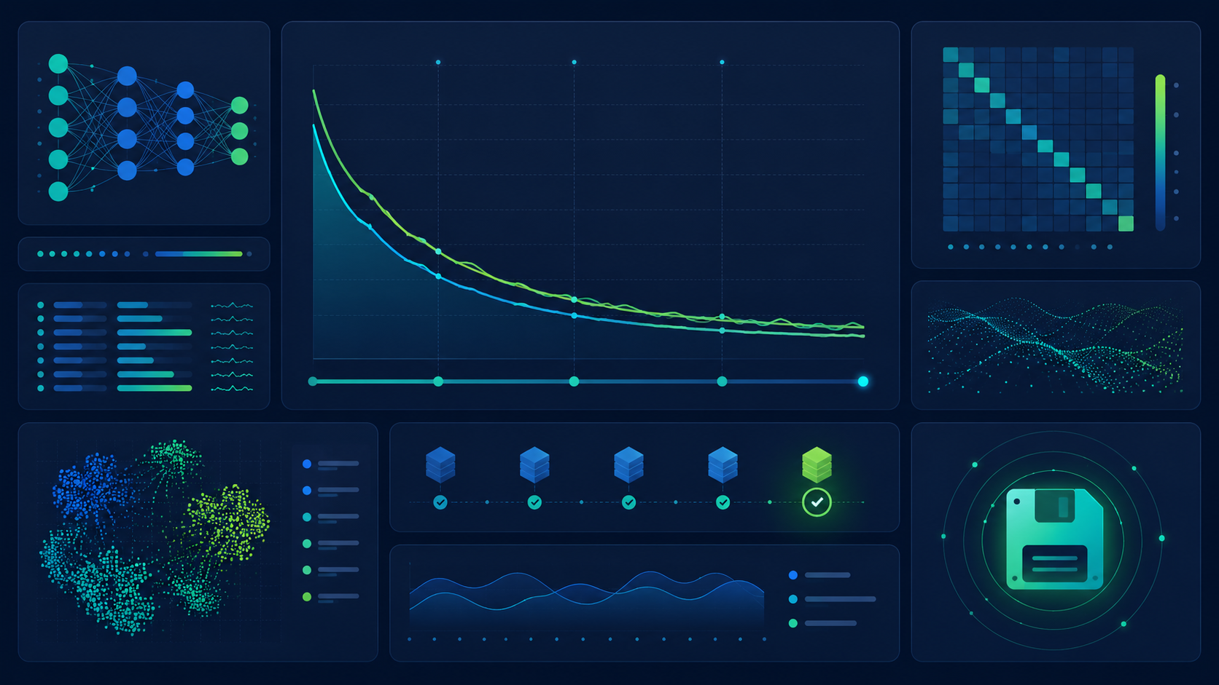
JRCAI
LEARNING MAP
What we will understand
From a small MLP to a complete training and evaluation workflow.
1
Model
MLP, neurons, layers, activations
2
Learning
Forward pass, loss, backward pass
3
Training choices
Initialization, optimizers, scheduling
4
Generalization
Dropout, BatchNorm, early stopping
Goal: explain the core ideas, not memorize formulas.
5
Finish
Evaluation, checkpointing, reloading
JRCAI | Joint Research Center for AI (SDAIA - KFUPM) • Deep Learning Fundamentals
02 / 28

Slide 3
JRCAI
BIG PICTURE
Deep learning is a repeatable learning loop
The model guesses, measures the error, learns from gradients, then repeats.
Mental model
PyTorch core line
The network does not “know” at first. It improves because each update slightly reduces future mistakes.
loss.backward() calculates gradients; optimizer.step() changes weights.
Data
Model
Loss
Backward
Update
new weight = old weight − learning rate × gradient
JRCAI | Joint Research Center for AI (SDAIA - KFUPM) • Deep Learning Fundamentals
03 / 28

Slide 4
JRCAI
01 | MLP
Multi-Layer Perceptron
A feed-forward neural network made of input, hidden, and output layers.
Plain definition
An MLP learns a mapping from input features to an output by passing numbers through connected layers.
Example tasks
Classification: disease risk, image label, spam detection.
Regression: score, price, temperature.
Input → Hidden Layers → Output
Input
Hidden 1
Hidden 2
Output
JRCAI | Joint Research Center for AI (SDAIA - KFUPM) • Deep Learning Fundamentals
04 / 28

Slide 5
JRCAI
MLP BUILDING BLOCK
A neuron is a weighted calculator
Each neuron combines inputs, adds bias, then applies an activation function.
x₁
Σ
activation
output
x₂
x₃
Key idea
z = w₁x₁ + w₂x₂ + w₃x₃ + b
output = f(z)
Weights are the learnable numbers. Bias shifts the result.
JRCAI | Joint Research Center for AI (SDAIA - KFUPM) • Deep Learning Fundamentals
05 / 28

Slide 6
JRCAI
PYTORCH VIEW
MLP architecture in code
In PyTorch, layers are usually defined inside nn.Module.
mlp_model.py
nn.Linear
class MLP(nn.Module):
def __init__(self):
super().__init__()
self.net = nn.Sequential(
nn.Linear(input_size, 128),
nn.ReLU(),
nn.Linear(128, 64),
nn.ReLU(),
nn.Linear(64, num_classes)
)
def forward(self, x):
return self.net(x)
Learns weighted combinations of input features.
Activation
Adds non-linearity so the model can learn complex patterns.
Output layer
Returns raw scores for classes or one value for regression.
Important: for CrossEntropyLoss, output raw logits — do not add Softmax inside the model.
JRCAI | Joint Research Center for AI (SDAIA - KFUPM) • Deep Learning Fundamentals
06 / 28

Slide 7
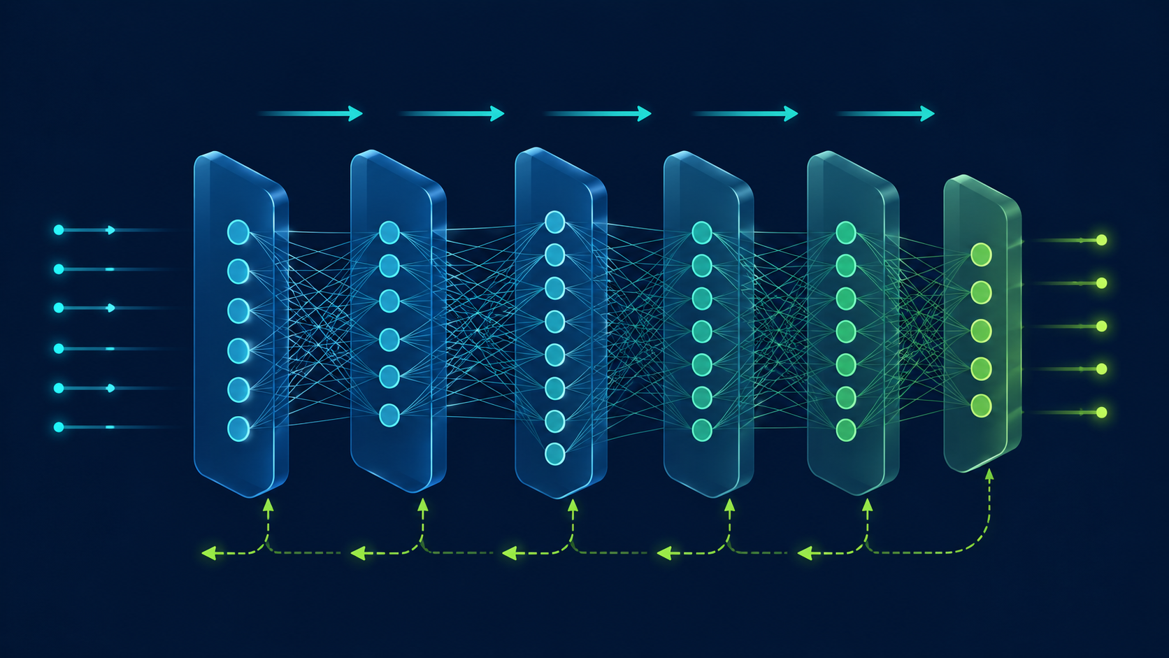
JRCAI
02 | FORWARD PASS
Forward propagation: make a prediction
Input moves from the first layer to the output using the current weights.
What happens?
Each layer transforms the previous layer output until the final prediction is produced.
prediction = model(x)
Not learning yet
A forward pass only produces a guess. Learning starts when we compare it with the target and compute loss.
JRCAI | Joint Research Center for AI (SDAIA - KFUPM) • Deep Learning Fundamentals
07 / 28

Slide 8
JRCAI
03 | BACKWARD PASS
Backpropagation: learn from the mistake
PyTorch follows the computation graph backward and computes gradients.
Gradient
A direction signal showing how each weight affects the loss.
Autograd
Automatically applies the chain rule. We do not calculate derivatives by hand.
Input
Hidden 1
Hidden 2
Output
loss.backward()
Then optimizer.step() uses the gradients to update the weights.
JRCAI | Joint Research Center for AI (SDAIA - KFUPM) • Deep Learning Fundamentals
08 / 28

Slide 9
JRCAI
TRAINING ENGINE
The PyTorch training loop
This pattern repeats for every batch and every epoch.
training_loop.py
1
Clear old gradients
for x, y in train_loader:
optimizer.zero_grad()
outputs = model(x) # forward
loss = loss_fn(outputs, y)
loss.backward() # gradients
optimizer.step() # update
2
Predict with model
3
Measure loss
4
Backpropagate
5
Update weights
One epoch
One epoch means the model has seen the full training dataset once.
JRCAI | Joint Research Center for AI (SDAIA - KFUPM) • Deep Learning Fundamentals
09 / 28

Slide 10
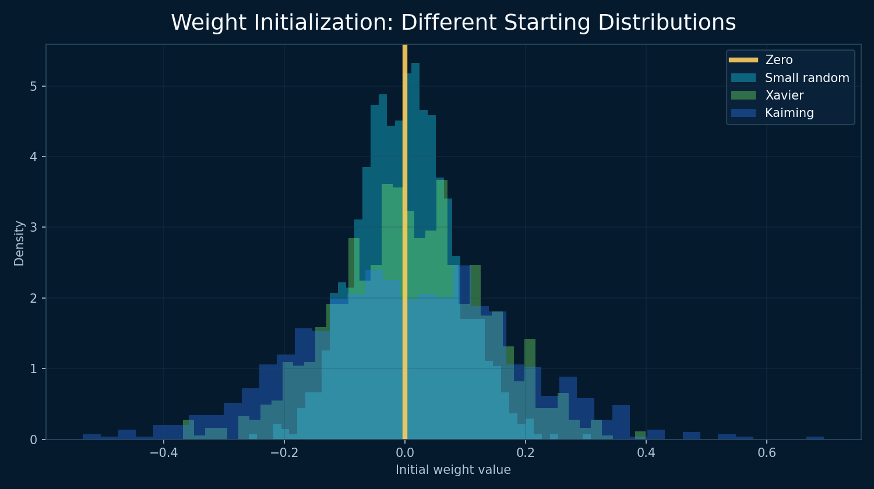
JRCAI
04 | INITIALIZATION
Weight initialization: the starting point matters
Bad initial weights can make training slow or unstable.
Why not all zeros?
All neurons start identical and learn the same thing, so the hidden layer wastes capacity.
Why random?
Random values break symmetry so neurons can learn different patterns.
Why smart random?
Xavier and Kaiming scale weights based on layer size to keep signals stable.
Rule of thumb: ReLU → Kaiming/He • Tanh/Sigmoid → Xavier/Glorot
JRCAI | Joint Research Center for AI (SDAIA - KFUPM) • Deep Learning Fundamentals
10 / 28

Slide 11
JRCAI
INITIALIZATION METHODS
The most useful methods to know
You do not need to memorize every method — focus on when each one is used.
Zero
All weights = 0
Usually bad for weights; okay for many biases
Random
Small random values
Basic symmetry breaking
Xavier / Glorot
Scales by input + output size
Common with Tanh/Sigmoid
He / Kaiming
Scales for ReLU-style layers
Common with ReLU/LeakyReLU
Orthogonal
Preserves directions
Sometimes deep/RNN models
Good initialization keeps activations and gradients at reasonable sizes.
JRCAI | Joint Research Center for AI (SDAIA - KFUPM) • Deep Learning Fundamentals
11 / 28

Slide 12
JRCAI
05 | LOSS FUNCTIONS
Loss: how wrong was the model?
The loss converts prediction errors into one number the optimizer can minimize.
Regression
Binary classification
Multiclass classification
Predict a continuous number: score, price, temperature.
Common losses: MSE, MAE, SmoothL1.
Two possible outcomes: spam/not spam, disease/no disease.
Common loss: BCEWithLogitsLoss.
One class among many: cat/dog/bird, risk level.
Common loss: CrossEntropyLoss.
Training goal: minimize loss over many batches
loss_step.py
prediction = model(x)
loss = loss_fn(prediction, y)
loss.backward()
JRCAI | Joint Research Center for AI (SDAIA - KFUPM) • Deep Learning Fundamentals
12 / 28

Slide 13
JRCAI
REGRESSION LOSS
Mean Squared Error (MSE)
MSE is used when the target is a number, not a category.
MSE = average((actual − predicted)²)
Why square the error?
Large mistakes are punished more strongly than small mistakes.
Example
Actual exam score = 76
Predicted score = 70
Error = 6, squared error = 36
mse_loss.py
loss_fn = nn.MSELoss()
loss = loss_fn(prediction, target)
Use for: prices • scores • sensor values • continuous predictions
JRCAI | Joint Research Center for AI (SDAIA - KFUPM) • Deep Learning Fundamentals
13 / 28

Slide 14
JRCAI
CLASSIFICATION LOSS
Cross-Entropy Loss
Cross-Entropy rewards high score for the correct class and penalizes confident wrong answers.
Cat
raw logit
PyTorch detail
nn.CrossEntropyLoss expects raw logits and integer labels. Do not add Softmax before it.
Dog
correct class high logit
Bird
raw logit
cross_entropy.py
loss_fn = nn.CrossEntropyLoss()
outputs = model(images) # logits
loss = loss_fn(outputs, labels)
Multiclass classification → CrossEntropyLoss
JRCAI | Joint Research Center for AI (SDAIA - KFUPM) • Deep Learning Fundamentals
14 / 28

Slide 15
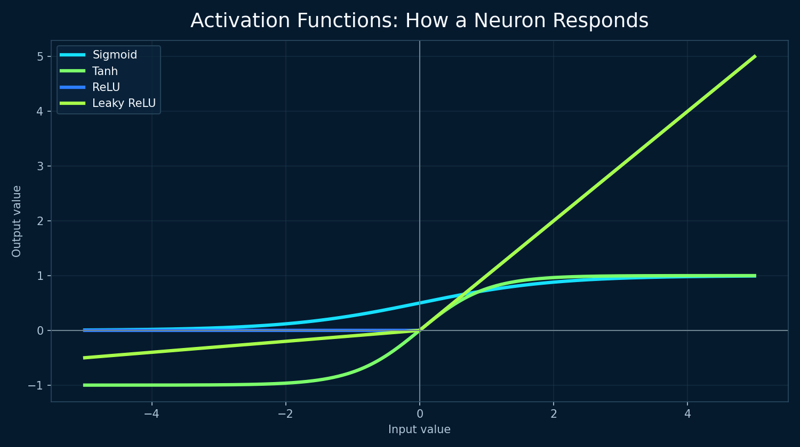
JRCAI
06 | ACTIVATIONS
Activation functions add non-linearity
Without activations, many linear layers still behave like one linear transformation.
ReLU
Fast and common in hidden layers. Negative values become zero.
LeakyReLU
Like ReLU, but lets a small negative signal pass.
Sigmoid / Tanh
Useful historically and in specific outputs, but can suffer from vanishing gradients.
Use activations to let the network learn curves, boundaries, and complex patterns.
JRCAI | Joint Research Center for AI (SDAIA - KFUPM) • Deep Learning Fundamentals
15 / 28

Slide 16
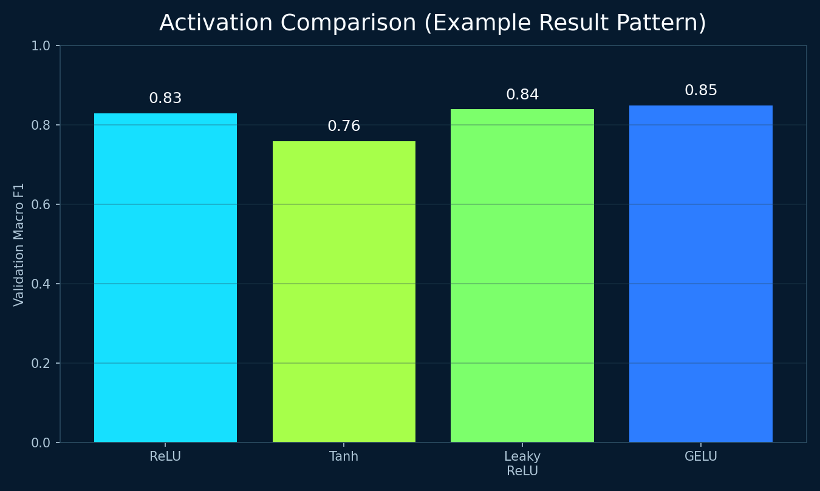
JRCAI
ACTIVATION CHOICE
Which activation should I use?
Choose based on where the layer is and what the output means.
Hidden layers
Binary output
Multiclass output
Start with ReLU or LeakyReLU for normal MLPs. GELU is common in Transformers.
Sigmoid can turn one logit into a probability from 0 to 1.
Softmax turns class scores into probabilities, but do not add it before CrossEntropyLoss.
For experiments, compare activations fairly: same dataset, same architecture, same optimizer.
JRCAI | Joint Research Center for AI (SDAIA - KFUPM) • Deep Learning Fundamentals
16 / 28

Slide 17
JRCAI
07 | OPTIMIZERS
Optimizers update the weights
They use gradients from backpropagation to reduce future loss.
new weight = old weight − learning rate × gradient
SGD
RMSProp
Adam / AdamW
Simple gradient steps. Momentum helps reduce zig-zagging.
Adapts updates using recent gradient sizes.
Adaptive + momentum-like behavior. Strong default for many projects.
optimizer.py
optimizer = torch.optim.Adam(
model.parameters(),
lr=0.001
)
JRCAI | Joint Research Center for AI (SDAIA - KFUPM) • Deep Learning Fundamentals
17 / 28

Slide 18
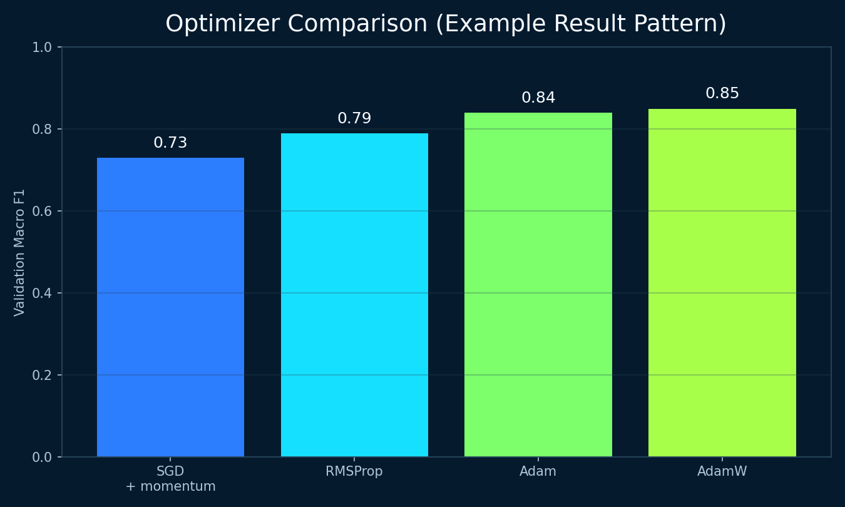
JRCAI
OPTIMIZER COMPARISON
Compare optimizers using the same dataset
A fair comparison changes one thing at a time.
SGD + Momentum
Often reliable, but may need more tuning of learning rate and momentum.
RMSProp
Useful adaptive method; historically common in recurrent networks.
Adam / AdamW
Convenient default. AdamW is especially common when weight decay is used.
Do not claim “best optimizer” universally — report what performed best in your experiment.
JRCAI | Joint Research Center for AI (SDAIA - KFUPM) • Deep Learning Fundamentals
18 / 28

Slide 19
JRCAI
08 | REGULARIZATION
Dropout: randomly turn neurons off
Dropout reduces overfitting by preventing neurons from depending too much on each other.
During training
Some activations are set to zero randomly.
During evaluation
Dropout is disabled with model.eval().
dropout_layer.py
Input
Hidden 1
Hidden 2
Output
nn.Dropout(p=0.3)
Simple memory: Dropout = “do not memorize using only a few neurons.”
JRCAI | Joint Research Center for AI (SDAIA - KFUPM) • Deep Learning Fundamentals
19 / 28

Slide 20
JRCAI
BATCH NORMALIZATION
BatchNorm keeps activations well-behaved
It normalizes layer outputs and then learns scale and shift parameters.
Raw layer output
Normalize batch
Scale + shift
Next layer
Helps training
Train vs eval
batchnorm_layer.py
Can stabilize optimization and sometimes allow larger learning rates.
Training uses batch statistics; evaluation uses stored running statistics.
nn.BatchNorm1d(128)
JRCAI | Joint Research Center for AI (SDAIA - KFUPM) • Deep Learning Fundamentals
20 / 28

Slide 21
JRCAI
USING THEM TOGETHER
Dropout + BatchNorm in an MLP
A common block: Linear → BatchNorm → Activation → Dropout.
Linear
BatchNorm
ReLU
Dropout
Next layer
regularized_block.py
Important experiment rule
nn.Linear(64, 128)
nn.BatchNorm1d(128)
nn.ReLU()
nn.Dropout(0.3)
Do not only add regularization. Compare baseline vs Dropout vs BatchNorm vs both and report the validation results.
JRCAI | Joint Research Center for AI (SDAIA - KFUPM) • Deep Learning Fundamentals
21 / 28

Slide 22
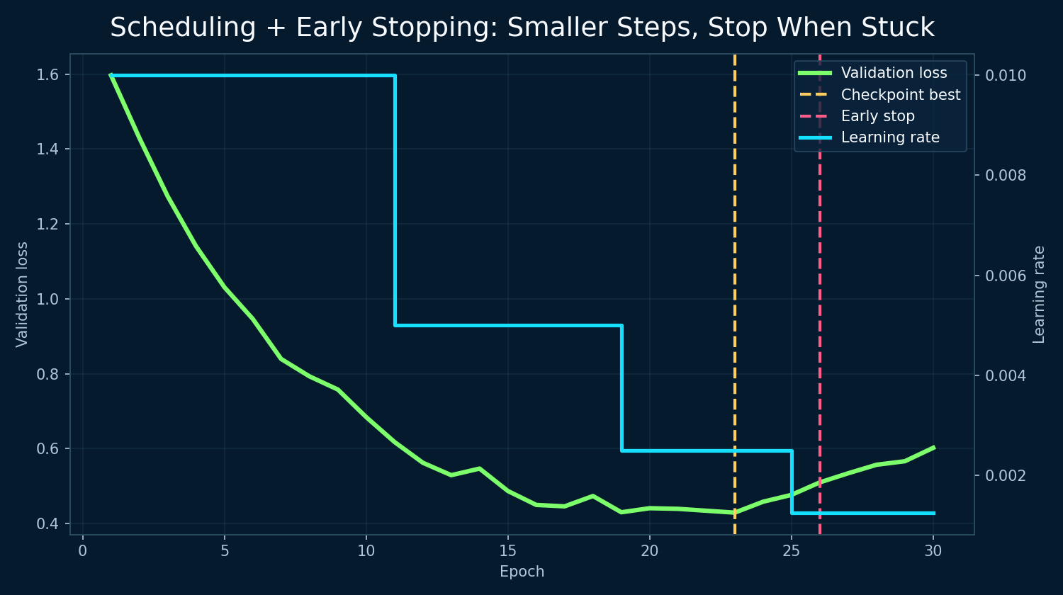
JRCAI
09 | LEARNING-RATE SCHEDULING
Change step size during training
Large steps can help early; smaller steps help fine-tune later.
Learning rate
Controls how big each optimizer update is.
Scheduler
Automatically changes lr over epochs or when validation loss stops improving.
scheduler.py
scheduler = ReduceLROnPlateau(
optimizer, factor=0.5, patience=3
)
scheduler.step(val_loss)
JRCAI | Joint Research Center for AI (SDAIA - KFUPM) • Deep Learning Fundamentals
22 / 28

Slide 23
JRCAI
10 | EARLY STOPPING
Stop when validation no longer improves
Early Stopping helps avoid wasted training and can reduce overfitting.
Best val loss improves
No improvement
Counter = patience
Save checkpoint
reset patience
Increase counter
Stop training
patience = number of bad epochs tolerated before stopping
JRCAI | Joint Research Center for AI (SDAIA - KFUPM) • Deep Learning Fundamentals
23 / 28

Slide 24
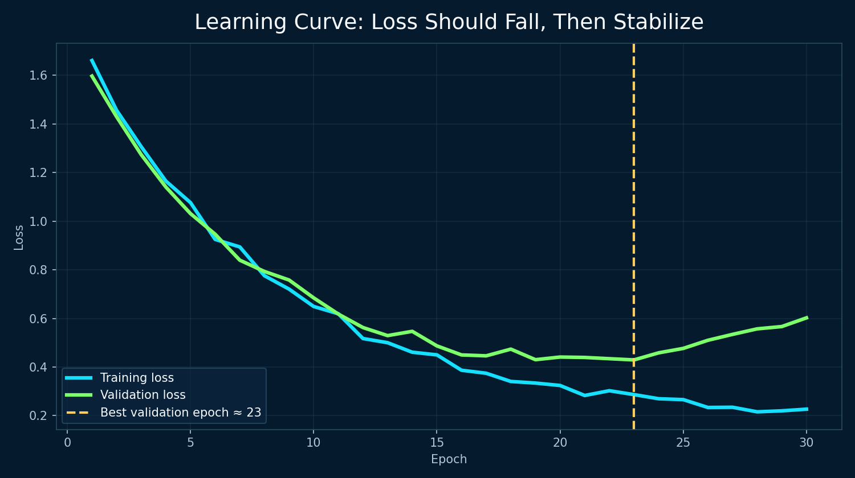
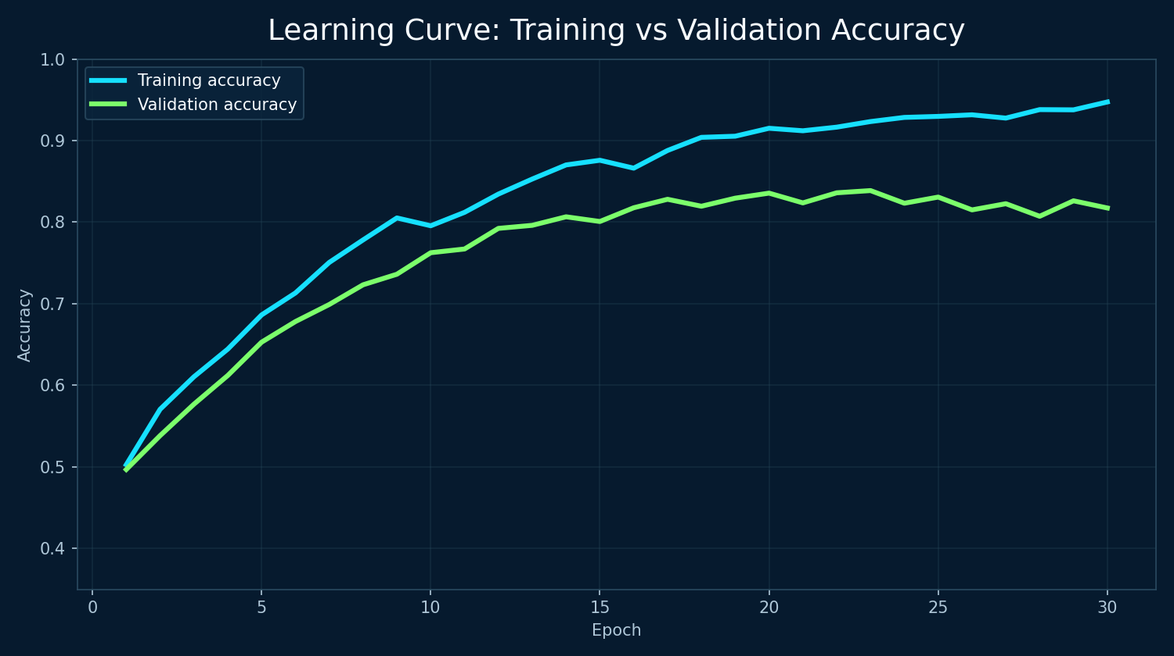
JRCAI
LEARNING CURVES
How to read training vs validation curves
Curves show whether the model is learning, overfitting, or underfitting.
Good sign
Overfitting sign
Underfitting sign
Both training and validation loss decrease, then stabilize.
Training improves while validation gets worse.
Both training and validation performance remain poor.
JRCAI | Joint Research Center for AI (SDAIA - KFUPM) • Deep Learning Fundamentals
24 / 28

Slide 25
JRCAI
11 | CHECKPOINTING
Save the best model, not only the last model
Checkpointing lets you resume training or reload the best validation model later.
Epoch 1
Epoch 2
Epoch 3
Epoch 4
Epoch 5
BEST
save_checkpoint.py
load_checkpoint.py
torch.save({
"epoch": epoch,
"model_state_dict": model.state_dict(),
"optimizer_state_dict": optimizer.state_dict(),
"validation_loss": best_val_loss
}, "best_model.pth")
checkpoint = torch.load("best_model.pth")
model.load_state_dict(
checkpoint["model_state_dict"]
)
model.eval()
JRCAI | Joint Research Center for AI (SDAIA - KFUPM) • Deep Learning Fundamentals
25 / 28

Slide 26
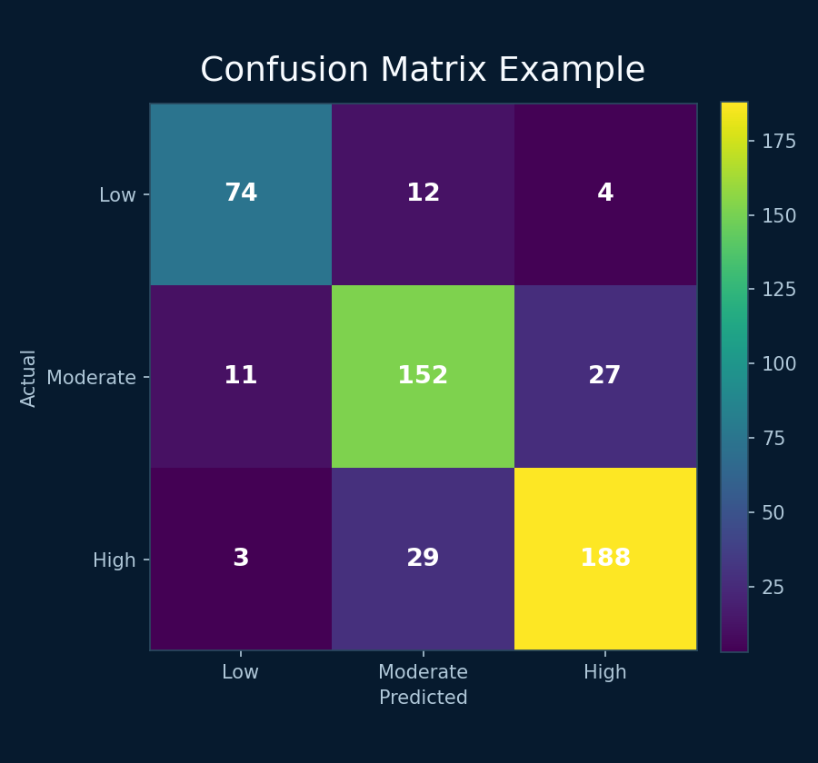
JRCAI
12 | EVALUATION
Evaluate on unseen data
Evaluation checks whether the trained model generalizes beyond the training set.
Classification
model.eval()
Accuracy, precision, recall, F1-score, confusion matrix, ROC-AUC where appropriate.
Switches Dropout/BatchNorm into evaluation behavior.
Regression
torch.no_grad()
MAE, MSE, RMSE, R². These measure prediction error for numbers.
Disables gradient tracking to save memory and time.
Final rule: tune with validation set, report final results on test set.
JRCAI | Joint Research Center for AI (SDAIA - KFUPM) • Deep Learning Fundamentals
26 / 28

Slide 27
JRCAI
END-TO-END WORKFLOW
How everything fits together
A complete MLP project follows a disciplined sequence.
Data
Preprocess
MLP
Loss
Backprop
Optimizer
Validate
Checkpoint
Evaluate
The same idea appears in most PyTorch projects: data → model → loss → gradients → update → evaluate.
JRCAI | Joint Research Center for AI (SDAIA - KFUPM) • Deep Learning Fundamentals
27 / 28

Slide 28
KEY TAKEAWAYS
MLP Training
in One Slide
1
Forward pass makes a prediction.
2
Loss measures how wrong it is.
3
Backprop calculates gradients.
4
Optimizer updates weights.
Questions?
5
Validation, regularization, and checkpointing keep the model useful.
JRCAI | Joint Research Center for AI (SDAIA - KFUPM)
28 / 28

